Slide 1
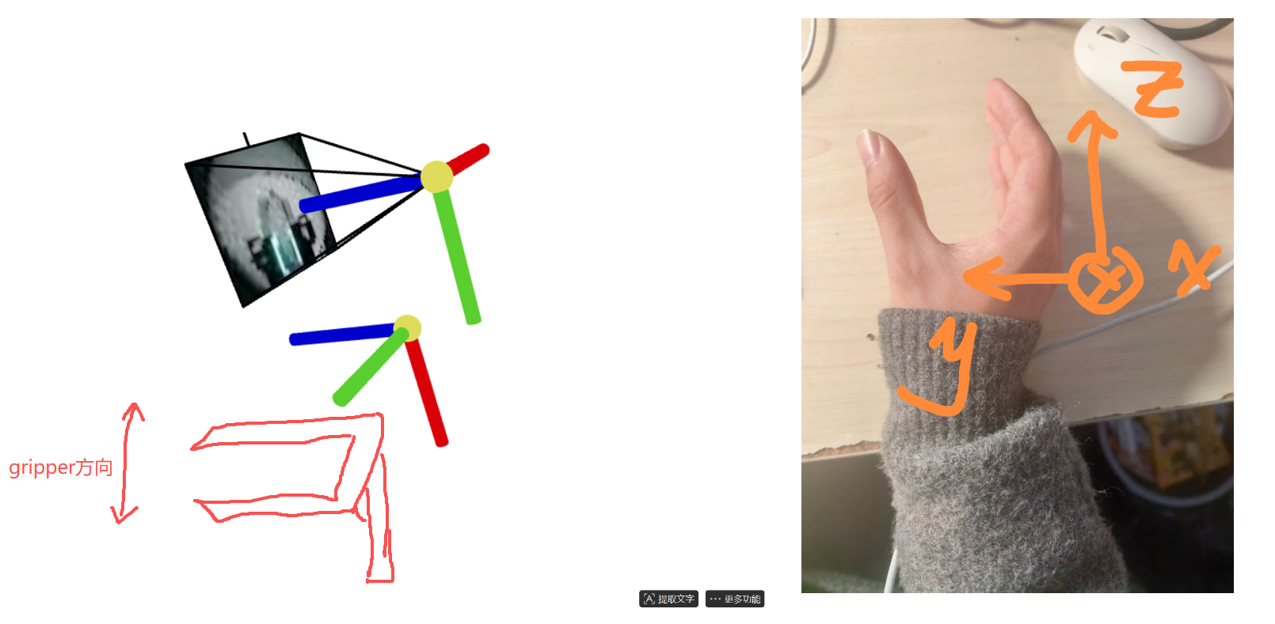
Definition of UMI Canonical Frame
Definition of the Camera's Canonical Coordinate System: For the view frustum and forward-facing direction, the camera's canonical coordinate system is defined with the Z-axis (blue) pointing forward, X-axis (red) pointing right, and Y-axis (green) pointing down.
For the egocentric data of the gripper itself, we approximate the gripper using the human hand grasping posture in the figure below.

Slide 2
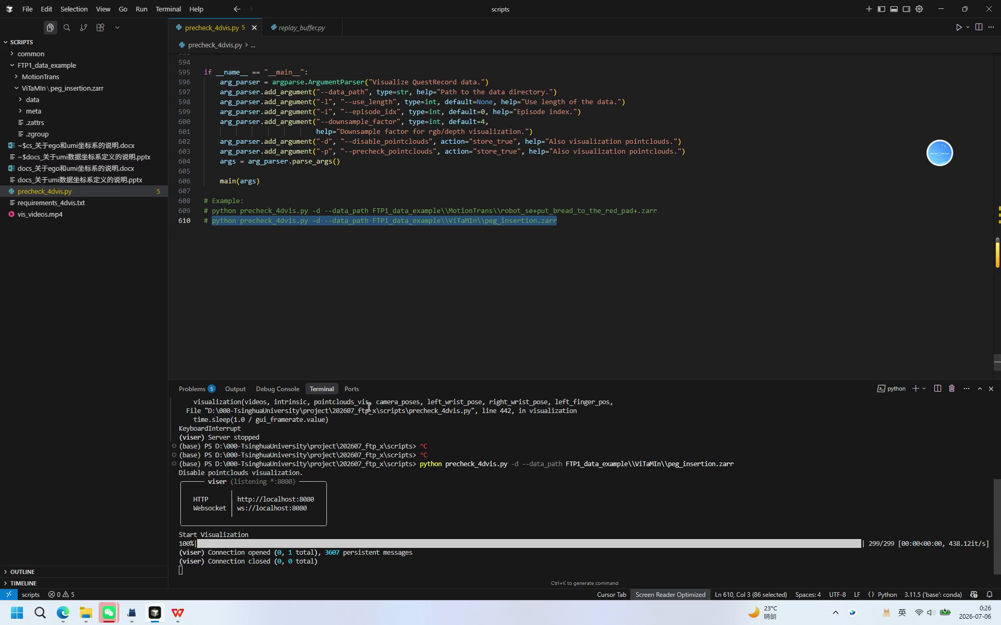
How to check？
(Video available on the right side)
Run precheck_4dvis.py
Switch to a "camera forward" perspective in Viser, and click "Playing" to change to manual playback.
Then drag the progress bar to check whether the movement trend of the gripper coordinate below matches the trend in the video.
For example, in the right-side case, the movement trend of the gripper coordinate relative to the initial position is forward and then backward, which matches the video.
Also, make sure to check whether the orientation of the initial gripper coordinate is Z forward (blue), X down (red), and Y left (green) when the "camera is forward"; refer to the previous page for a detailed explanation.

